Slide 1
What is Cloud Computing?
Cloud computing is a model for enabling ubiquitous, convenient, on-demand network access to a shared pool of configurable computing resources (e.g., networks, servers, storage, applications, and services) that can be rapidly provisioned and released with minimal management effort or service provider interaction [1].
Informal: Cloud Computing = computing with large datacenters.
Our focus: Cloud Computing = computing as a utility outsourced to a third party or internal org
[1] Peter Mell (NIST), Tim Grance (NIST),
The National Institute of Standards and Technology (NIST) Definition of Cloud Computing
https://csrc.nist.gov/publications/detail/sp/800-145/final

Slide 2
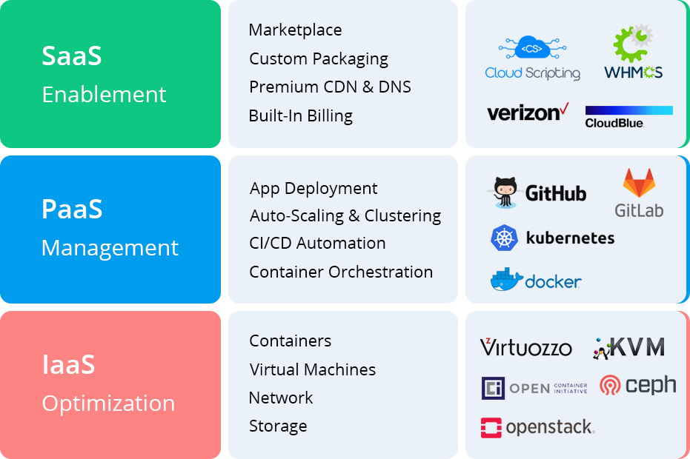
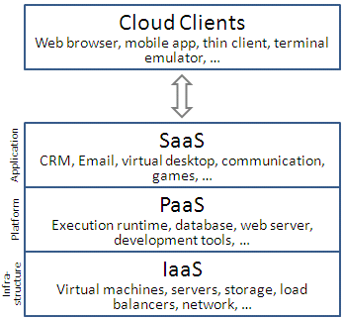
Service Models
Infrastructure as a Service (IaaS), Platform as a Service (PaaS),
Software as a Service (SaaS)

Slide 3
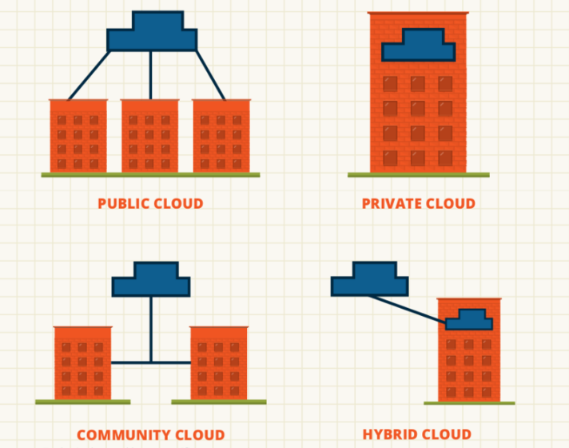
Deployment Models
Infrastructure as a Service (IaaS), Platform as a Service (PaaS),
Software as a Service (SaaS)
Notes:
Private cloud. The cloud infrastructure is provisioned for exclusive use by a single organization comprising multiple consumers (e.g., business units). It may be owned, managed, and operated by the organization, a third party, or some combination of them, and it may exist on or off premises.
Community cloud. The cloud infrastructure is provisioned for exclusive use by a specific community of consumers from organizations that have shared concerns (e.g., mission, security requirements, policy, and compliance considerations). It may be owned, managed, and operated by one or more of the organizations in the community, a third party, or some combination of them, and it may exist on or off premises.
Public cloud. The cloud infrastructure is provisioned for open use by the general public. It may be owned, managed, and operated by a business, academic, or government organization, or some combination of them. It exists on the premises of the cloud provider.
Hybrid cloud. The cloud infrastructure is a composition of two or more distinct cloud infrastructures (private, community, or public) that remain unique entities, but are bound together by standardized or proprietary technology that enables data and application portability (e.g., cloud bursting for load balancing between clouds).

Slide 4
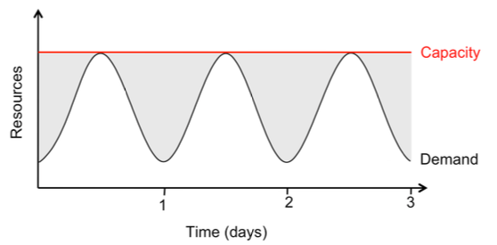
Cloud Economics: For Users
Pay-as-you-go (usage-based) pricing:
Most services charge per minute, per byte, etc
No minimum or up-front fee
Helpful when apps have variable utilization

Slide 5
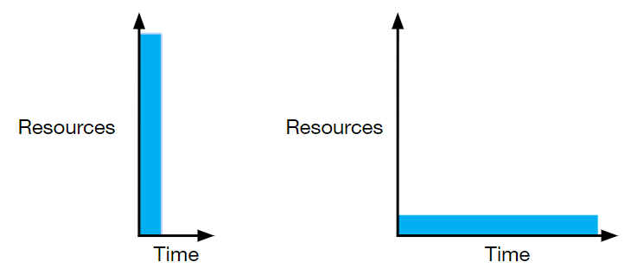
Cloud Economics: For Users
Elasticity:
Using 1000 servers for 1 hour costs the same as 1 server for 1000 hours
Same price to get a result faster!

Slide 6
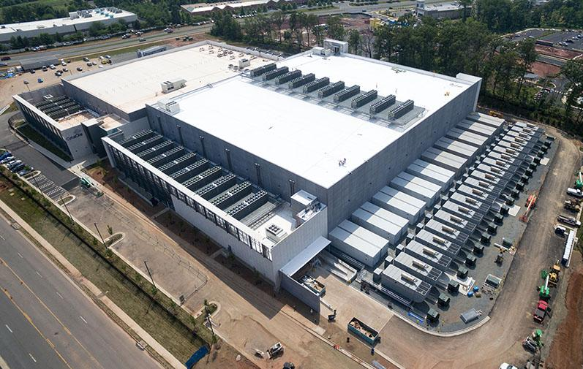
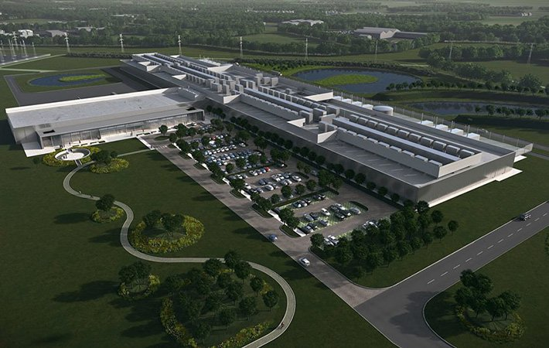
Cloud Economics: For Providers
Economies of scale:
Purchasing, powering & managing machines at scale gives lower per-unit costs than customers’
To find Tradeoff: fast growth vs efficiency
To find Tradeoff: flexibility vs cost

Slide 7
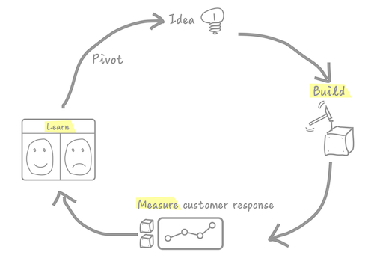
Cloud Economics: For Providers
Speed of iteration:
Software as a service means fast time-to-market, updates, and detailed monitoring/feedback
Compare to speed of iteration with ordinary software distribution

Slide 8
Other Interesting Features
Spot market for preemptible machines, the ability to purchase a productive old server
Wide geographic access for disaster recovery and speed of access
Ability to quickly try exotic hardware
Ability to A/B test anything

